Slide 1
Repeating Tables
PrintNet T

Slide 2
Agenda
Repeated Overflowing Tables

Slide 3

Repeated Tables – Purpose
  Design of complex tables with repeated body and variable content.
  Tables overflow to another page.
  Usage of different headers and footers.

Slide 4

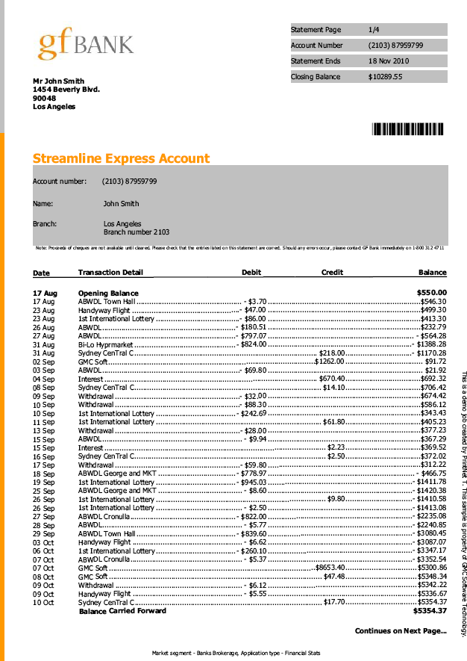
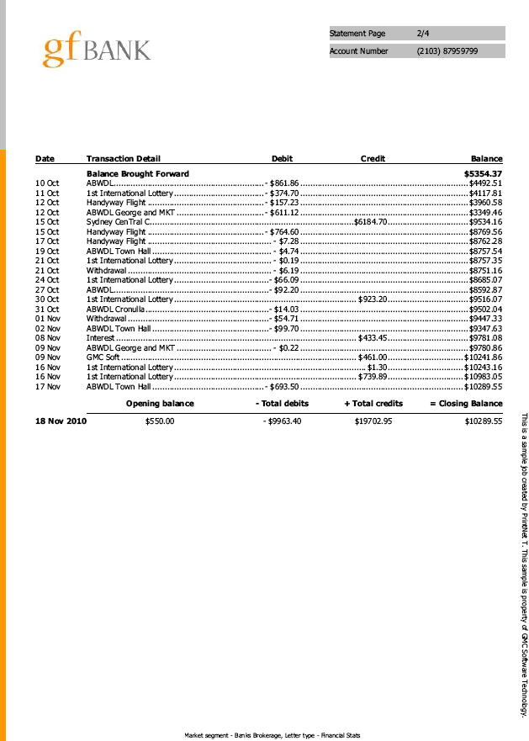
Repeated Tables – Example
  Bank statement for one person
Notes:
This example is from “Getting started”.
It shows an overflowing table with a first header/header and footer/last footer
There is also Variable page selection applied (first page – cont. page)‏

Slide 5

Repeated Tables – Introduction
Complex tables consist of:
  Header
  Body
  Footer
HEADER
BODY
FOOTER
Notes:
Header and footer are “common header” and “common footer”. They are universal for the whole table.

Slide 6
Repeated Tables – Schema
PAGE 1
PAGE 2
PAGE 3
PAGE 4
First Header
Header
Header
Header
Body
Body
Body
Body
Footer
Footer
Footer
Last Footer
Notes:
The table consists of three basic parts – header, body, and footer
If the table overflows to other pages, the first part of the table is separated to First header and header. The last part is separated to footer and last footer.
First header is visible only on the first page, the last footer only on the last page.
All pages between the first and the last contain the header and footer (see the schema).
The body is repeated by a variable. It can be repeated by records (main array) or by any other variable in accordance with correct layout. Be careful not to be out of context!

Slide 7
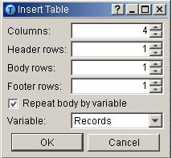
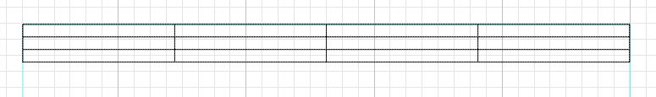
Repeated Tables
Number of header rows
Number of body rows
Number of footer rows
Notes:
It is very important to tell the trainees, they set number of header or footer rows, not the number of headers or footers!!!!!

Slide 8
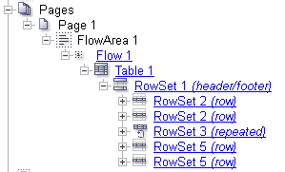
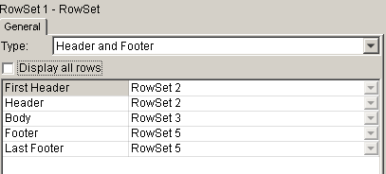
Repeated Tables
Layout Tree (the names are default)‏
Layout Properties of RowSet1
Notes:
First header and Header use the same RowSet. There is no difference between them by default. Footer and Last Footer also share the same Rowset. Different Headers and Footers can be specified if it is necessary for them to be different from the First Header and Last Footer.

Slide 9
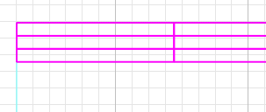
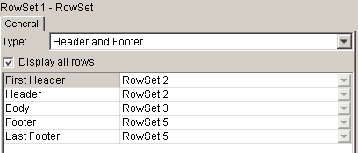
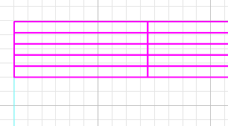
Repeated Tables
Display all rows in the table for better overview.
Notes:
In this phase, the First Header and Header use the same RowSet. The checkbox “Display all rows” is unchecked by default.
The content of First Header/Header is identical (i.e., uses the same RowSet), so the content will be seen twice if we check the “Display all rows” checkbox (only in Layout though, not in proof).
It is applied to the Footer/Last Footer in the same way.

Slide 10
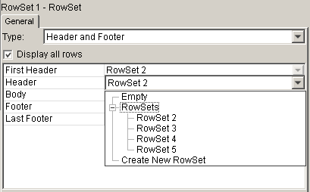

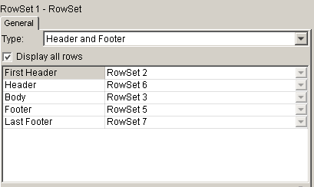
Repeated Tables
Distinguish RowSets
Different RowSets for each part of the table
Notes:
Different RowSets can be assigned to First Header/Header or Footer/Last Footer to distinguish their content from each other.
Headers and Footers can be set to Empty if the design requires it to be so.
Tell the difference between RowSet: Type Row and RowSet: Type Rowset – it will be presented later, but this could be a good time to mention it.

Slide 11

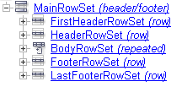
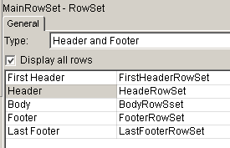
Repeated Tables
It is highly recommended to rename Rowsets in the Layout tree.
Notes:
RowSets can be renamed sooner or maybe later – it depends on a user’s habits.

Slide 12
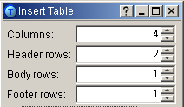
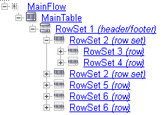
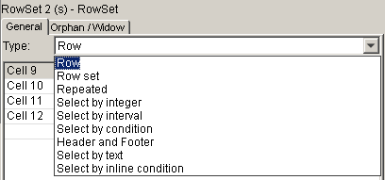
Repeated Tables
Number of rows (more than one in the same RowSet)‏
RowSet type
Adding new RowSet
Notes:
RowSet types are modified according to the change of row count from Type Row to Type RowSet.
It can be set:
automatically in the first pop-up dialog window by setting the number of header, body, and footer rows; or…
manually in Layout Properties for each RowSet by adding a new item.
RowSet (Type RowSet) can contain more RowSets (Type Row) – example: multiple rows in First Header or Footer etc.

Slide 13

Repeated Tables – Exercise
Create a table with different First Header, Header, Footer, and Last Footer.
  Open OverflowTable.wfd.
  Create a flow area and insert a table with 4 columns, 1 header row, and 1 footer row. 1 body row should be repeated by Records.
  Change the RowSets so that there is a different RowSet for each part of the table.
  Fill the body of the table with Name, Surname, City, and ZIP variables.
  Merge cells in Headers and Footers, fill their content and apply proper text styles.
  Set variable pages and correct overflowing.
  Proof the job <F6>.
Notes:
Check OverflowTable_done.wfd for resolution.
Flow area should be 15x15cm or similar. This size creates enough pages to demonstrate First Header/Header and Footer/Last Footer functionality.
Mention that this is not a real job, just the sample showing the basic structure of repeated table! The real table will follow in the final exercise.

Slide 14

Repeated Tables – Summary
In this part of the presentation we have learned:
  How to:
    Create a table with a header, body, and footer
    Set the RowSets
    Distinguish First Header, Header, Footer, and Last Footer
    Change the RowSet type
    Add more rows to a table (automatically and manually)‏

Slide 15

Repeated Tables – Discussion
What are the parts of a complex table?
What is the difference between First Header and Header?
What parts will be applied to a one-paged complex table?
How can another row be added?
Notes:
1. What are the parts of a complex table?
Header, Body, Footer (or more complex – First Header, Header, Body, Footer, Last Footer)‏
2. What is the difference between First Header and Header?
First Header is only on first page, Header is on the next pages
3. What parts will be applied to a one-paged complex table?
First Header, Body, Last Footer
4. How can another row be added?
Change the RowSet from type Row to type RowSet and then click on Add new item

Slide 16

Thank You.
Do You Have Any Questions?

